Slide 1
私隱及網絡安全
- 政策和框架
10 July 2019

Slide 2
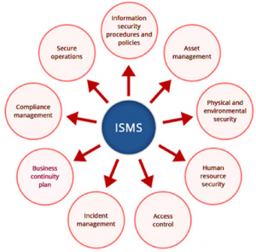
Information Security Management Framework
Based on ISO 27001
  (US : NIST)
Describe “organised approach” – whole school
Based on Risk Management
Address Confidentiality, Integrity and Availability
Anchor on :
  People, Process, IT System
https://www.anitechconsulting.com.au/what-is-isms-and-how-will-it-impact-your-business/

Slide 3
ISMS Key Issues
Risk Management
Information Security Policy
  Guidelines, Procedures
  Roles and Responsibilities
  Technical Implementation

Slide 4
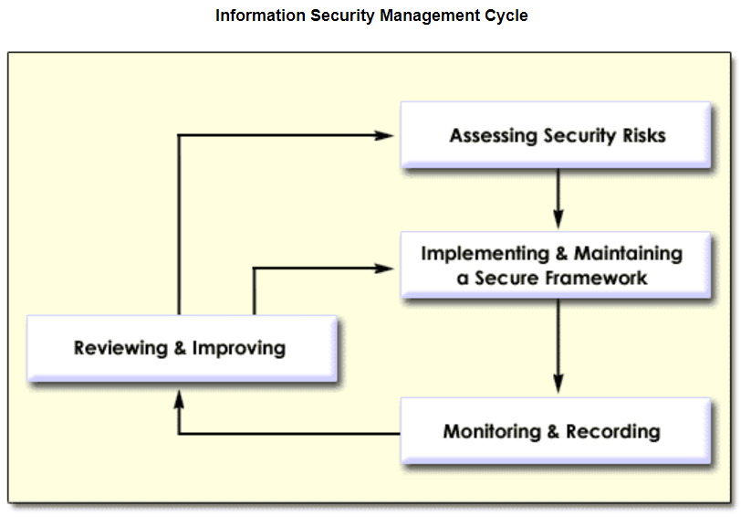
Information Security Management Cycle
Security Policy
Roles and Responsibilities
Security Controls
Source : https://www.infosec.gov.hk/english/business/security_smc.html

Slide 5
Risk Assessment – School Example
Confidentiality | Integrity | Availability
Student Data | Accounting | Network / WiFi
Teacher / HR Data | Payroll | School email system
Exam papers | Exam Grades / Assessment Data | Admin / Learning Systems

Slide 6
Risk Registry
Vulnerabilities | Impact | Likelihood | Risk Level
Student Data | High | High | High
Payroll Data | Medium | Medium | Medium
Exam papers | High | Medium | High
Attendance Record | Low | Low | Low

Slide 7
Risk Mitigation Analysis - States
Description | Storage | Processing and I/O | Transmission
Student Data | eClass server, WebSAMS, Cloud Storage Backup, USB, Paper Document | Excel, Server, Paper Form Filling | School network, public network, Email, File sharing, Paper mails
Payroll | Payroll System, School Server, Paper forms | Payroll System, Excel, Calculator | LAN only, Letter distribution
Exam papers | Teacher Personal Storage School Server | MS Office Other editing tools Grading Tools | LAN only, Paper distribution

Slide 8
Related Legislations
Theft and damage of property (digital assets)
Personal data protection
Copyright / IP rights
Software Asset Management
Digital marketing and unsolicited electronic messages
Electronic Transactions Ordinance
Safety in the use of Display Screen Equipment

Slide 9
Policies, Standards, Guidelines, Procedures
Policies
Principles, intentions, directional
Clearly defines AUTHORITIES, ROLES and RESPONSIBILITIES
Standards
Compliance – data centre, encryption
Guidelines
More detail description to guide operation
Procedures
Detailed step-by-step instructions that should be followed

Slide 10
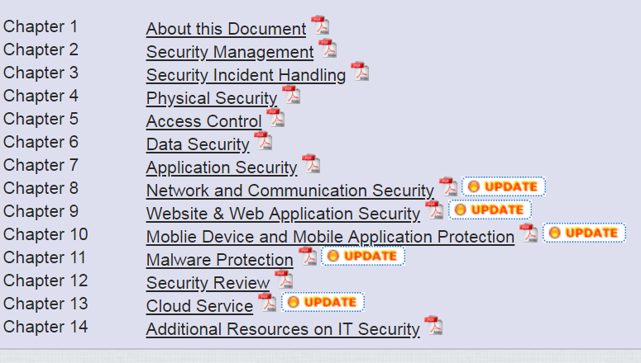
Roles and Responsibilities
Information Security in Schools - Recommended Practice (2019)
Chapter 2 Security Management
2.2 Security Policy
2.3 Security Personnel
  School Head
  IT Head
  IT Committee Members
  Technical Support Staff
2.4 IT Security Functions
Details:
https://www.edb.gov.hk/en/edu-system/primary-secondary/applicable-to-primary-secondary/it-in-edu/Information-Security/information-security-in-school.html

Slide 11
 | Responsibilities
Incorporated Management Committee (IMC) | Approve policies Delegate authority to Principals Risk Management Crisis Management
IT Committee under IMC | Delegated with the above duties by the Council
School Supervisor | Execution and Monitoring of the above
School Principal | Implement IS policy Resource (budget, manpower) provision Overall responsibilities covering IT and non-IT
IT Head (Information Security Officer) | Overall responsibility of IT related issues Implement the IT infrastructure and procedures accordingly Formulate IT guidelines and procedures
IT technical staff | Carry out duties according to guidelines and procedures
Teachers with IT related duties (sensitive data, privileged accounts) | Understanding the guidelines and procedures related to their special duties
Teacher Users | Follow the guidelines and procedures Comply with legal requirements Comply with teacher code of conducts
Student Users | Understand AUP Comply with school requirements for students (conduct, discipline) Comply with legal requirements

Slide 12
IMC and Principal
Conduct Risk Assessment
Develop IS Policies
Assign Roles and Responsibilities
Monitoring and Review

Slide 13
FOR IT HEAD - Infrastructure and Systems Related
Network Security – private network, remote access
Server security – patch and upgrades, rights management
Classifying sensitive data (personal data, mailbox, exam papers etc.)
Managing file storage, backup and cloud services, IT Assets (keys)
Security in IT Procurement and Service Contracts, third party services
Managing Technical Support Staff – security training, procedures, monitoring
Reviewing system statistics and logs
Managing privileged / admin accounts
Managing staff / student accounts
Use school provided accounts instead of personal accounts (cloud account)
Use school provided email instead of personal emails
Automatic removal of rights after staff / student leaving
Not using real name with third party systems

Slide 14
Personal Data Handling
Collection – PICS / Consent Form
Minimum data – no unnecessary HKID, address, phone in student list, email, reports etc.
Encryption – in storage, processing and transmission
  Especially : USB, email, Excel
Hash Key – Integrity of data
Transfer to third parties (e.g. publishers)

Slide 15
Third Party Transfer Check List
Agreement with third parties on purpose and usage of personal data
Clear authority on who can transfer data
Encryption in storage and transmission
Hash Key to protect integrity and reduce liability
Contractual rights to request removing data upon request
Clear record of who transferred the data
Choose what data fields to be transferred
Clear record what data has been transferred
Secure transfer system (not email, WhatsApp etc).

Slide 16






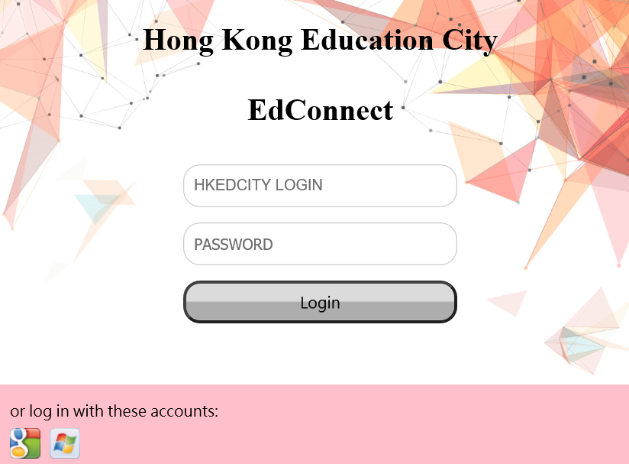

出版社
香港教育城
學校
Agreement with third parties on purpose and usage of personal data – EdData Standard Agreement
Clear authority on who can transfer data -School Admin
Encryption in storage and transmission - EdData
Hash Key to protect integrity and reduce liability - EdData
Contractual rights to request removing data upon request -Standard Agreement, Revoke Functions
Clear record of who transferred the data - School Admin)
Choose what data fields to be transferred – EdData
Clear record what data has been transferred – EdData Log
Secure transfer system (not email, WhatsApp etc). - EdData
Agree
Agree
Data
Request
Approve
Get Data
Logs
EdDATA
電子教科書及電子學習資源
EdConnect 2.0
學生 /
教師 /
BYOD

